Slide 1

HARCOURT BUTTLER TECHNOLOGICAL INSTITUTE KANPUR DEPARTMENT OF COMPUTER SCIENCE AND ENGINEERING
GALAXIAN SHOOTING
COMPUTER GRAPHICS PROJECT USING OPENGL
SUBMITTED TO: SUBMITTED BY:
DR. NARENDRA KOHALI AMBRISH AWASTHI(86/13)
H.O.D CSE AMIT GAUTAM(87/13)
HBTI KANPUR DEEPAK KUMAR(93/13)
GAURAV SHARMA(526/14)

Slide 2
ABSTRACT
Galaxy Shooting is an Open-GL based 2D game.
This project was done as a part of Computer Graphics Course,
The project was made with an objective of learning 2D Animations and basic transformations.

Slide 3
CONTENTS
Inroduction to opengl
Main Features
About Galaxian Shooting
Design & Implementation
Conclusion & future scope

Slide 4
INTRODUCTION TO OPENGL
The Open Graphics Library (OpenGL) is used for visualizing 2D and 3D data. It is a multipurpose open-standard graphics library that supports applications for 2D and 3D digital content creation, mechanical and architectural design.
OpenGL Utility Library(GLU)
OpenGL Utility Toolkit(GLUT)

Slide 5
MAIN FEATURES
Use of primitive OpenGL functions to draw object.
Interactive Input
Collision detection
Mouse hover effect in menu
Animation Using Double Buffering to avoid Flicker
Highscore saved using file

Slide 6
PLAY CONTROLS
Left Key = Move the ship left
Right Key = Move the ship right
Spacebar/Left Click = Shooting
'P'/'p'/Right Click = Pause/Resume Game
'R'/'r' = Resume Game (Works only in Pause Game Screen)
'Q'/Esc Key = Quit Game
'S'/'s' = Start the game (works only in start screen)

Slide 7
DESIGN & IMPLEMENTATION
FUNCTIONS
START MENU
MAIN SHIP
PAUSE MENU
EXIT MENU
THANK YOU MENU

Slide 8
FUNCTIONS
Some Opengl Standard Functions Used
glPushMatrix();
glPopMatrix();
glColor3f(float r,float g,float b);
glBegin();
glVertex2f(float x,float y);
glEnd();
GL_POLYGON
GL_LINE_LOOP
GL_MODEL_VIEW

Slide 9
glutInitDisplayMode (GLUT_DOUBLE | GLUT_RGBA | GLUT_DEPTH);
glutKeyboardFunc();
glutKeyboardUpFunc();
glutSpecialFunc();
glutSpecialUpFunc();
glutPassiveMotionFunc();
glutMouseFunc();
glutTimerFunc();
glutPostRedisplay();

Slide 10
Some User defined Functions Used
Drawing.cpp
draw_background()
draw_main_ship();
draw_bombs();
draw_bullets();
darw_score_board();
draw_start_menu();
draw_pause_menu();
draw_quit_menu();
draw_thank_you_menu();

Slide 11
move.cpp
main_ship_move();
bomb_move();
bullet_move();
detect_collisions();
collision_bomb_ship();
collision_bomb_bullet();

Slide 12
Utility.cpp
cirsetpix()
dispcir()
add_bullet()
Callback.cpp
normal_key()
normal_key_up();
keyboard_func();
keyboard_up_func();
mouse_motion()

Slide 13
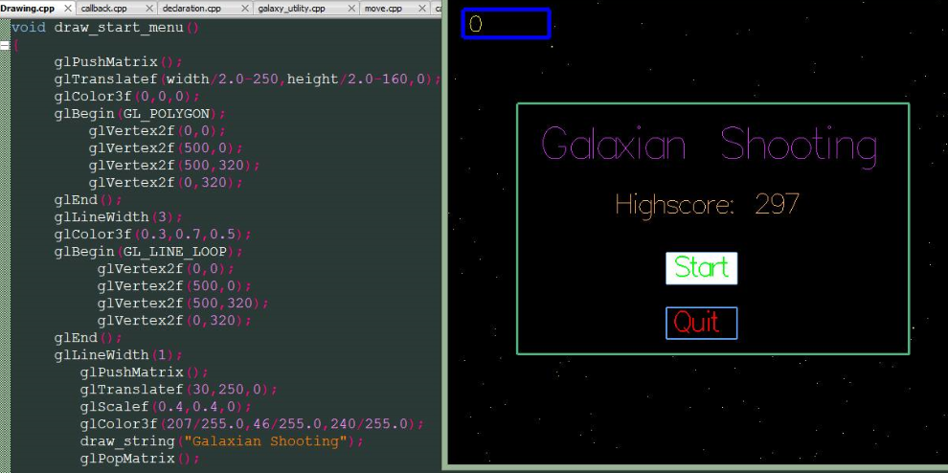
START MENU

Slide 14
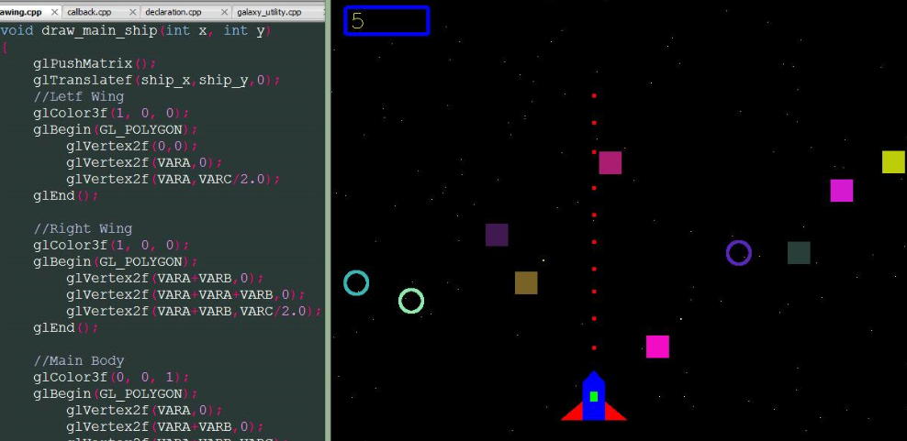
MAIN SHIP

Slide 15
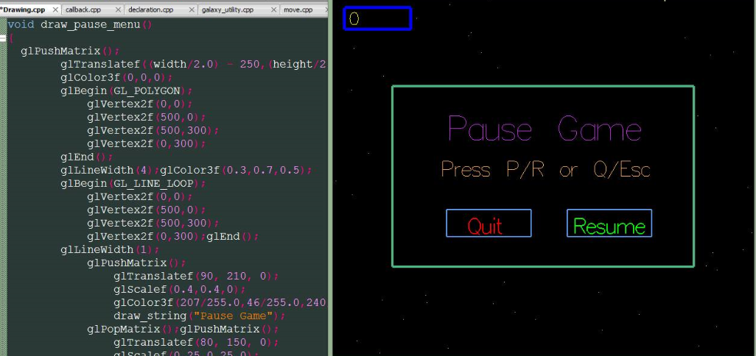
PAUSE MENU

Slide 16
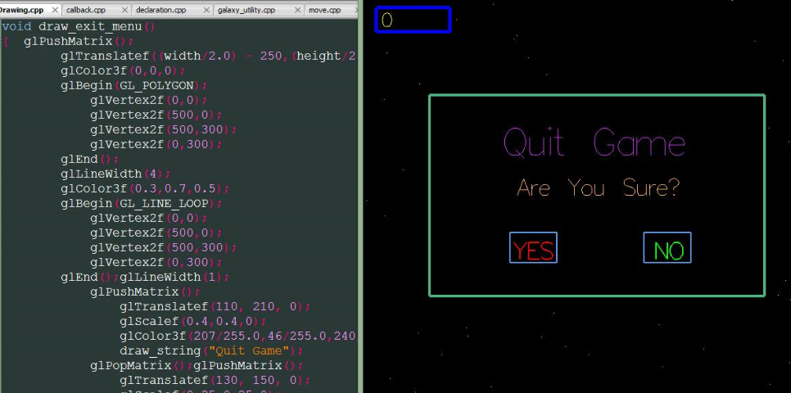
EXIT MENU

Slide 17
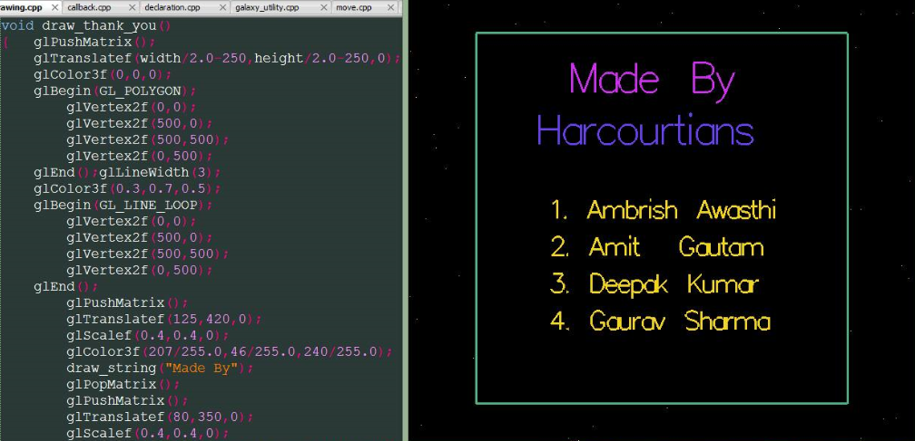
THANK YOU

Slide 18
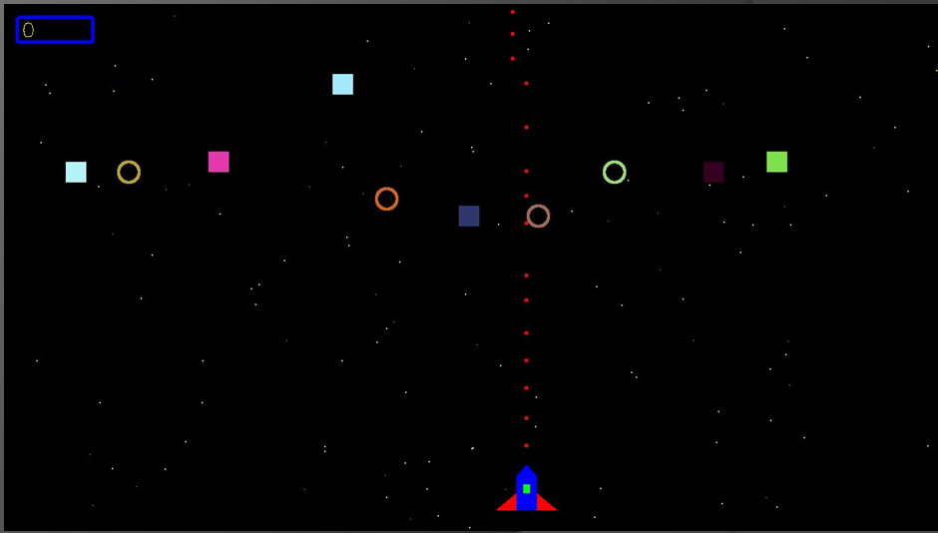
RESULT

Slide 19
CONCLUSION
The GALAXIAN SHOOTING game has been improvised with graphical approach.
The demo is made more iterative with mouse interaction module in the program.

Slide 20
FUTURE SCOPE
The game designed is two dimensional demo. In future, it can be redesigned with 3D animation and sound effects.
Future scope of computer graphics
Animation
Game Industries
Multimedia
Entertainment
Business

Slide 21
THANK YOU

